Slide 1
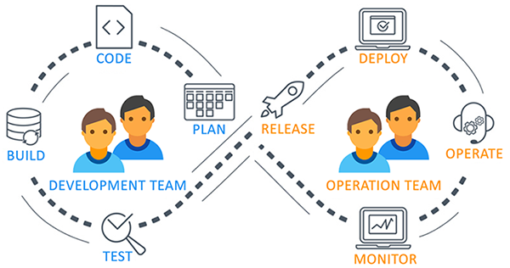
Azure DevOps
Azure DevOps is Microsoft’s cloud-based suite of tools that helps teams plan, develop, test, deliver, and monitor software in a collaborative and automated way.
Azure DevOps is a set of development tools and services provided by Microsoft to support the entire software development lifecycle.
Think of it as a complete DevOps lifecycle platform that integrates source control, CI/CD, agile project management, artifact storage, and test management.
Azure DevOps, a modern DevOps tool of planning, developing, testing and deploying modern apps.
Azure DevOps services are independent of cloud or platform.
It can be used:
On the cloud → Azure DevOps Services
On-premises → Azure DevOps Server (formerly Team Foundation Server - TFS)

Slide 2
Why Choose Azure DevOps?
Azure DevOps stands out as a comprehensive and flexible platform for modern software development teams.
Here are the key reasons why organizations choose Azure DevOps:
🌐 1. All-in-One DevOps Platform
Azure DevOps offers a complete toolchain for software development and delivery:
Planning (Azure Boards)
Development (Azure Repos)
Testing (Azure Test Plans)
Delivery (Azure Pipelines)
Package Management (Azure Artifacts)
This reduces the need to integrate and manage multiple third-party tools.
🔁 2. Supports Any Language, Platform, or Cloud
Works with .NET, Java, Node.js, Python, and more.
Supports building and deploying to Windows, Linux, or macOS.
Compatible with Azure, AWS, GCP, or on-premises environments.

Slide 3
Why Choose Azure DevOps?
⚙️ 3. Strong Integration and Extensibility
Integrates with tools like GitHub, Slack, Docker, Kubernetes, Jenkins, etc.
Over 1000 extensions available in the Azure DevOps Marketplace.
📊 4. Enterprise-Ready
Backed by Microsoft’s cloud infrastructure for scalability and security.
Suitable for small teams to large enterprises.
🚀 5. Agile and DevOps Practices Out-of-the-Box
First-class support for Agile, Scrum, and Kanban methodologies.
Built-in CI/CD pipelines for automating the software lifecycle.
Encourages a culture of collaboration and continuous improvement.
💰 6. Cost-Effective and Flexible Pricing
Free tier for small teams (up to 5 users).
Pay-as-you-go model for larger teams.

Slide 4
Azure DevOps Benefits
Cloud & On-Prem Support → Use Azure DevOps Services or Server.
Integrations → GitHub, Jira, Slack, Teams, Docker, Jenkins.
Scalability → Works for a single developer or thousands of devs.
Security → Role-based access, branch policies, and audit logs.
Typical Use Cases
Managing Agile projects with boards & sprints.
Hosting code in private Git repos.
Building and deploying .NET, Java, Python, Node.js, etc.
Running automated tests before deployment.
Managing private package feeds for internal apps.

Slide 5
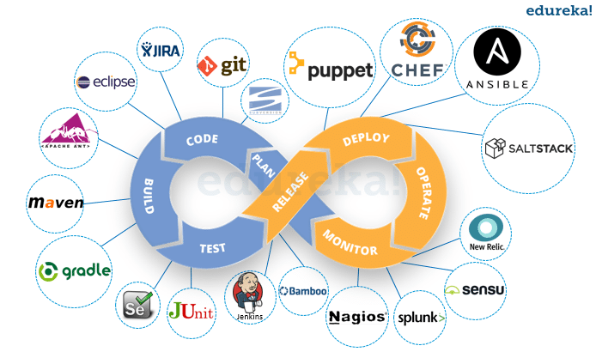
Tools for Azure DevOps
Azure DevOps works well with most of the DevOps tools.
Category | Tools Name
Configuration Tools | Chef, Ansible, Puppet
Continuous Integration | Jenkins
Microservices | Docker
Collaboration | Slack, Trello
Monitoring | Kibana, Grafana
Development | Visual Studio

Slide 6
Key Services/Components in Azure DevOps
Azure DevOps is made up of five core services, each addressing a specific part of the software development lifecycle. These components can be used together or individually, depending on your team's needs.
Azure Repos
Azure Pipelines
Azure Boards
Azure Test Plans
Azure Artifacts

Slide 7
Key Services/Components in Azure DevOps
1. Azure Boards
Purpose: Agile project management and work tracking.
Features:
Work items (user stories, bugs, tasks)
Kanban boards and Scrum support
Sprint planning and backlogs
Dashboards and reporting

Slide 8
Key Services/Components in Azure DevOps
2. Azure Repos
Purpose: Source code management.
Features:
Git repositories and Team Foundation Version Control (TFVC)
Pull requests and code reviews
Branching and merging strategies
Commit history and auditing

Slide 9
Key Services/Components in Azure DevOps
3. Azure Pipelines
Purpose: Continuous Integration (CI) and Continuous Delivery (CD).
Features:
Build automation and deployment workflows
Multi-platform support (Windows, Linux, macOS)
Container and Kubernetes support
YAML or classic editor pipelines
Integration with GitHub, Bitbucket, etc.

Slide 10
Key Services/Components in Azure DevOps
4. Azure Test Plans
Purpose: Manual and exploratory testing tools.
Features:
Test case management
Test execution and results tracking
Bug reporting directly from test runs
Rich data capture during testing sessions

Slide 11
Key Services/Components in Azure DevOps
5.Azure Artifacts
Purpose: Package management and distribution.
Features:
Host and share NuGet, npm, Maven, Python, and Universal packages
Integrates with CI/CD pipelines
Controls over versioning and access
Rich data capture during testing sessions
Bonus: Extensions and Integrations
Azure DevOps integrates with a wide range of tools and has a marketplace for adding features such as Slack notifications, SonarCloud analysis, and more.

Slide 12
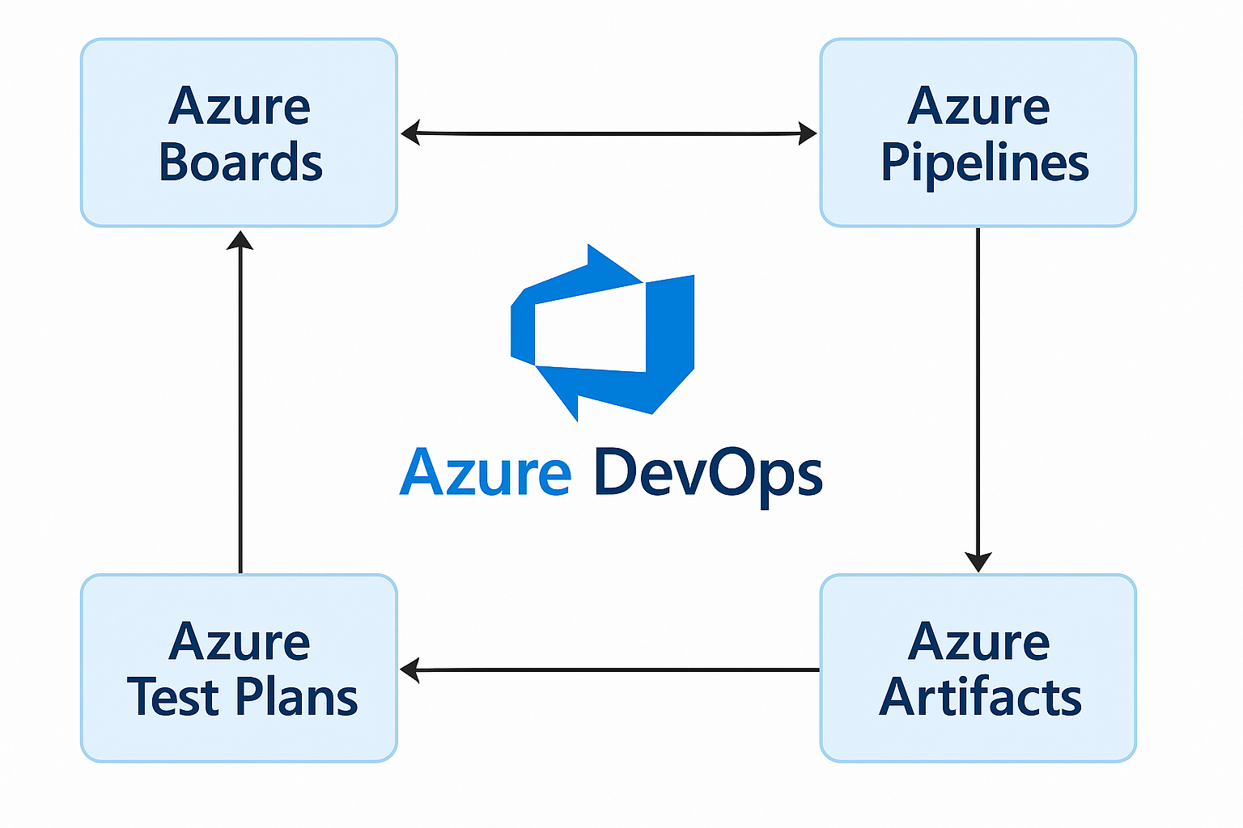
Key Services/Components in Azure DevOps

